Slide 1

Note: The data and information in this document is reflective of a hypothetical situation and client. This document is to be used for KPMG Virtual Internship purposes only.
Sprocket Central Pty Ltd
Data analytics approach
Bjarne Schmalbach

Slide 2
Note: The data and information in this document is reflective of a hypothetical situation and client. This document is to be used for KPMG Virtual Internship purposes only.
Agenda
Introduction
Data Exploration
Model Development
Interpretation

Slide 3
Note: The data and information in this document is reflective of a hypothetical situation and client. This document is to be used for KPMG Virtual Internship purposes only.
Introduction
The goal
Predict the customer (out of the data set of new customers) that is likely to yield the highest profit margin.

Slide 4
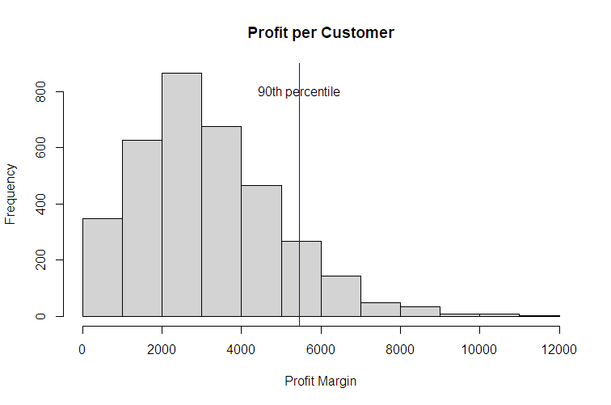
Note: The data and information in this document is reflective of a hypothetical situation and client. This document is to be used for KPMG Virtual Internship purposes only.
Data exploration
Per customer profit
Minimum = $15
Maximum = $11,669
90th percentile = $5,466
Relevant customer predictors:
State
Postcode
Property valuation
Gender
Recent bike-related purchases
Wealth segment
Tenure
Car ownership
Job

Slide 5
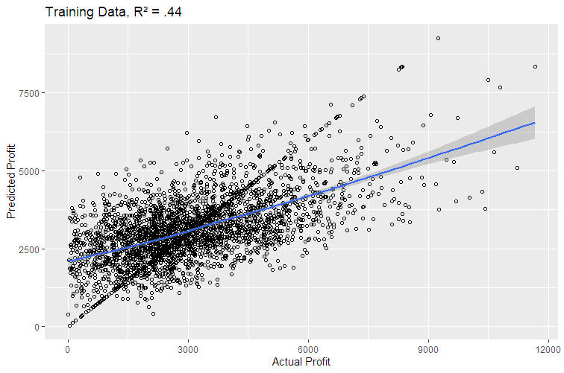
Note: The data and information in this document is reflective of a hypothetical situation and client. This document is to be used for KPMG Virtual Internship purposes only.
Model Development
Good model fit in the training data (R² = .44)
Based on the predictors mentioned on the last slide, actual profits could be predicted with good accuracy.

Slide 6
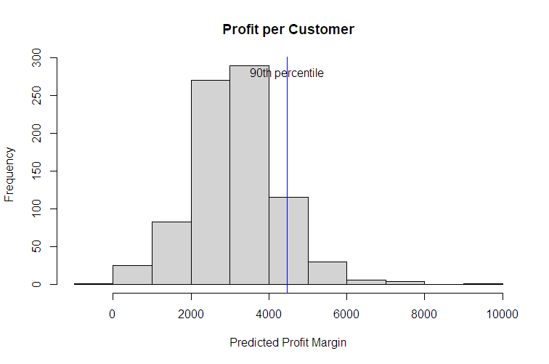
Note: The data and information in this document is reflective of a hypothetical situation and client. This document is to be used for KPMG Virtual Internship purposes only.
Interpretation
In applying, this model to new customer data, we are able to identify the customers that are likely to yield the highest profit for the company.
Highest expected profit margin is $9,230.
[Torry de la Valette Parisot, 53 years old, Victoria, VP Marketing, 95 recent bike-related purchases]

Slide 7
Note: The data and information in this document is reflective of a hypothetical situation and client. This document is to be used for KPMG Virtual Internship purposes only.
Appendix

Slide 8
Note: The data and information in this document is reflective of a hypothetical situation and client. This document is to be used for KPMG Virtual Internship purposes only.
Appendix
This is an optional slide where you may place any supporting items.

